Slide 1
Attention, Social Influence & Homophily
Social Media Analytics
02/04/2019 (Session 2)

Slide 2
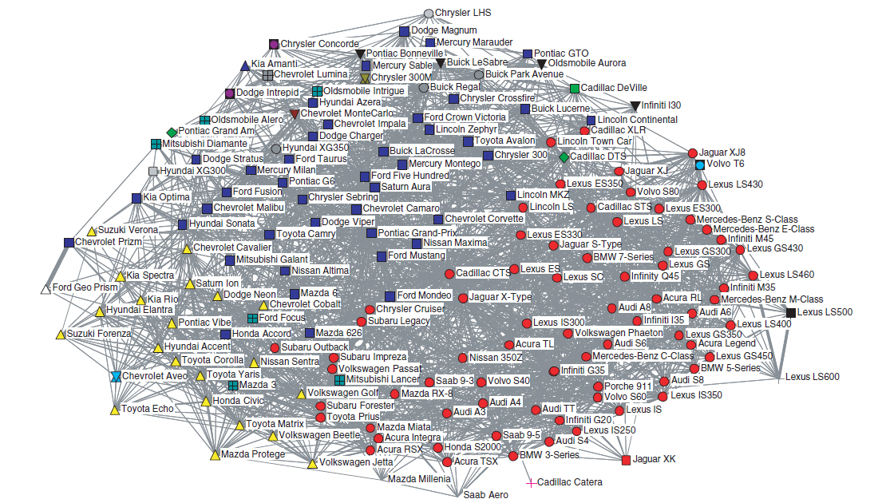
Not just People: Co-mentions of Car Models from Edmunds.com Sedan Forums

Slide 3
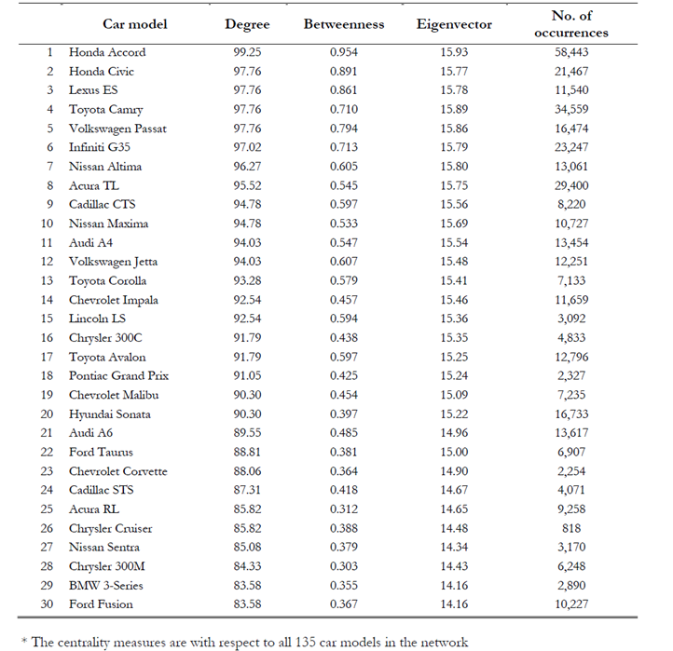

Slide 4
Finding Influential Social Media Users
Why bother?
What are some necessary attributes?

Slide 5
Analyzing Attention in Social Media: An Example from Twitter
Follower
Friend
You
Follower
Friend
Information
Attention

Slide 6
An Example
@dealtime | Deals galore at www.grabdeals.com
@itsonsale | Huge sale at crazysale.com
@shopnparty | Check out xyz.com for killer bargains.
@beerbudget | RT @itsonsale Huge sale at crazysale.com
@beerbudget | RT @dealtime Deals galore at www.grabdeals.com
@beerbudget | RT @shopnparty Check out xyz.com for killer bargains.
@dealtime | RT@ shopnparty Check out xyz.com for killer bargains.
@itsonsale | RT @shopnparty Check out xyz.com for killer bargains.
@itsonsale | RT @dealtime Deals galore at www.grabdeals.com
@shopnparty | Don’t miss the amazing laptop deal at www.laptops.com
@dealtime | RT @shopnparty Don’t miss the amazing laptop deal at www.laptops.com
@dealtime | Unbelievable offer. Check it out at pennysaver.com
@shopnparty | Super Memorial Day sale coming up at BargainBasement
@beerbudget | RT @dealtime Unbelievable offer. Check it out at pennysaver.com
Copyright Anitesh Barua 2017

Slide 7
How Much Attention Do You Command?
@shopnparty
1
.5
Flow of attention
.25
.5
@itsonsale
.25
@dealtime
.5
@beerbudget
Attention given by to | @shopnparty | @dealtime | @itsonsale | @beerbudget
@shopnparty | - | 0 | 0 | 0
@dealtime | 1 | - | 0 | 0
@itsonsale | .5 | .5 | - | 0
@beerbudget | .25 | .5 | .25 | -
Total attention received | 1.75/3 = 58.33% | 33.33% | 8.33%
Copyright Anitesh Barua 2017

Slide 8
The Case of High Note
Freemium business model
Very few upgrade to premium service
Allows social networking
Segmentation strategies for targeting?
Takeaways?

Slide 9
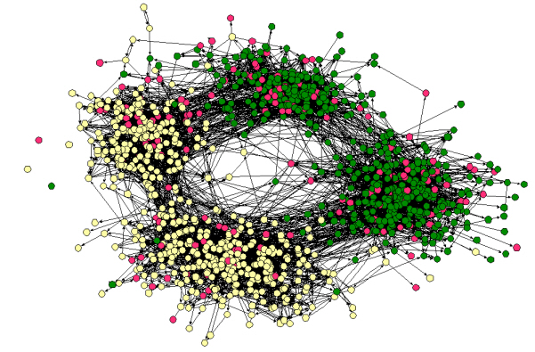
Homophily (Similarity)
“Birds of a feather flock together”
Your friends/contacts vs. a random sample of people
Social networks tend to connect people who are similar to each other
Friendships by race and across a middle and a high school in the same school district
Source: Easley & Kleinberg

Slide 10
Does It Matter?
Why do websites show ratings by your friends (if you use Facebook to log on)?
Does homophily play a role? How?
Pepsi social media chief sums up his strategy in one word: ‘Homophily’*
Source: http://www.businessinsider.com/pepsi-social-media-chiefs-strategy
-homophily-2012-9#ixzz2sF2Ls7v6

Slide 11
Distinguishing Between Social Influence and Homophily
Can opinions, attitudes & purchases be attributed to social influence?
Or is it due to homophily?
E.g., did I buy something because
you influenced me?
we are just similar?
What difference would it make to a company’s strategy?
Copyright Anitesh Barua 2018

Slide 12
When Attributes Are Static
$$A network with a set of nodes \left(V\right) \& randomly assigned edges \left(E^{r}\right):$$
$$R=\left(V, E^{r}\right)$$
Each node is assigned an attribute (say, gender = male) with probability p, and female with probability (1-p)
Consider any edge (i,j) ∈ E^{r} of this random network R.
Let the random variable X_{ij} = 1 if it is a “cross-edge”, and X_{ij} = 0 otherwise. Then X_{ij} is a Bernoulli random variable such that
P(X_{ij} = 1) = ?
Test of homophily: ?
Source: Easley & Kleinberg
Notes:
Probability = 2p (1-p)
Let (1-p) = q, then prob = 2pq

Slide 13
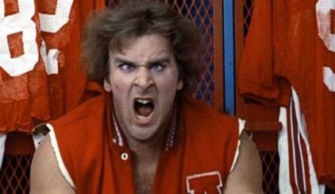

Detecting Homophily
Have to know what attribute(s) may be relevant
E.g., gender, interest, educational background, etc.
G
B
F
C
Jocks
I
A
Nerds
H
E
D
Does this network exhibit homophily?
What measure can we use?
Source: Easley & Kleinberg
Notes:
The revenge of the nerds
This exhibits that Jocks are more connected to jocks and nerds are more connected to nerds
Calculate if actual probability is equal to randomized probability
Total 9 people: 6 jocks, 3 nerds
P(random) = 2 * 6/9 * 3/9 = 4/9
P(actual) = 5/18
Another option is to do chi-square test

Slide 14
Distinguishing Between Homophily & Social Influence
G
C
G
B
B
C
A
F
F
A
E
E
D
D
Time: t t+1
 | Subscription
A | Yes
B | No
C | No
D | Yes
E | No
F | Yes
G | Yes
A | Yes
B | Yes
C | Yes
D | Yes
E | No
F | Yes
G | Yes
Attribute (e.g.,
subscription
to a music service
at time t
Attribute
at time t+1

Slide 15
Evidence of Homophily Versus Social Influence
G
C
G
B
G
B
C
A
B
C
F
F
A
F
A
E
Influence
E
D
D
Influence
D
E
Time: t t+1 t+2
Homophily
Homophily
A | Yes
B | No
C | No
D | Yes
E | No
F | Yes
G | Yes
A | Yes
B | Yes
C | Yes
D | Yes
E | No
F | Yes
G | Yes
Attribute
at time t
Attribute
at time t+1
Attribute
at time t+2

Slide 16
Dynamic Attributes: How Can We Distinguish Between Homophily & Influence?
Need multiple snapshots in time
Homophily: Due to similar attributes in time t, some people may choose to become friends in t+1
E.g., high achievers in a class may form links
But some people may become friends in t+1 even though their attributes were different in t
Check which effect is stronger
Source: LaFond & Neville

Slide 17
Test for Homophily
Homophily exists if
p(Becoming friends in t+1 where attributes were same in t) > p(Becoming friends in t+1 where attributes were different in t)
p(Dissolving friendships in t+1 where attributes were same in t) < p(Dissolving friendships in t+1 where attributes were different in t)
Source: LaFond & Neville

Slide 18
Detecting Social Influence
Some friends at t with different attributes may become similar in t+1 (due to social influence)
E.g., some buy a product their friends have
Some change their beliefs & attitudes
But people who are not friends and have different attributes at t can also become similar at t+1 due to “other” factors
Which effect is stronger?
I.e., is p(Attributes becoming same in t+1 where the individuals were friends in t) > p(Attributes becoming same in t+1 where the individuals were not friends in t)?
Is p(Attributes becoming different in t+1 where the individuals were friends in t) < p(Attributes becoming different in t+1 where the individuals were not friends in t)?
Source: LaFond & Neville

Slide 19
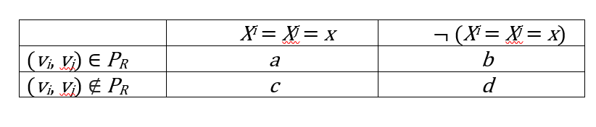
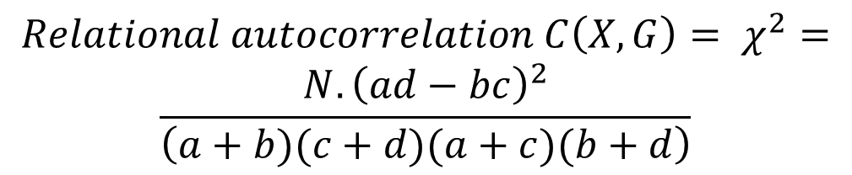

Testing Significance Levels
$$X^{i} is an atttribute of node v_{i}$$
$$P_{R} is a set of related nodes \left(friends\right) in a network$$
$${Relational autocorrelation C\left(X, G\right)= χ}^{2}=$$
$$\frac{N.{\left(ad−bc\right)}^{2}}{\left(a+b)(c+d)(a+c)(b+d\right)}$$
Source: LaFond & Neville

Slide 20
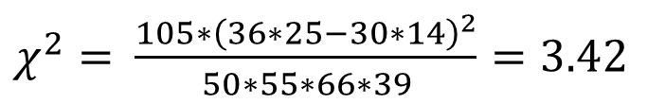

Chi-Square (for Contingency Tables)
 | Improved Outcome | Didn’t improve | Total
Treatment | 36 | 14 | 50
No Treatment | 30 | 25 | 55
Total | 66 | 39 | 105
$χ^{2}=$ $?$
$χ^{2}=$ $\frac{105∗{\left(36∗25−30∗14\right)}^{2}}{50∗55∗66∗39}=3.42$

Slide 21
Significance Tests
Homophily: ?
Social influence: ?

Slide 22
Not all Networks are
Created Equal
Possibility 1:
No social influence, no homophily
Possibility 2:
Social influence but no homophily
Possibility 3:
Homophily but no social influence
4th possibility (not shown): Both influence
& homophily
Copyright Anitesh Barua 2018

Slide 23
Homophily? Influence? Both? None?
“I started doing homework but ended up on Facebook”
“Honors Engineering Society”
“NOBAMA 2012”
“I bet I can still ﬁnd 1,000,000 people who dislike George Bush”
Source: LaFond & Neville

